Slide 1
Optimization of Machine Learning Classifiers with Direct Search Algorithms
Rachel You

Slide 2
Overview
To optimize machine learning classifiers, we need
Good parameters
Direct search: no need for derivatives
Algorithms chosen:
Nelder-Mead Algorithm
Method of Simulated Annealing
Application:
Support Vector Machine (SVM)
Notes:
In machine learning, besides good choices of classifiers and abundant data, good parameters for the classifier chosen are also essential in determining the goodness of classification. Finding the best parameters is an optimization problem. Optimization problems can also all be transformed into minimization problems, and be resolved with minimization algorithms. Minimizing functions in a multivariate case can be complicated when we are not able to take the derivative of the function. Nelder-Mead Algorithm and Method of Simulated Annealing are two methods to minimize a function without taking the derivative. We are going to examine each algorithm and apply each to tuning Support Vector Machine (SVM).

Slide 3
Nelder-Mead
reflection
expansion
simplex
check conditions
stopping criteria
met
optimal found
contraction
not met
shrinkage
Notes:
Nelder-Mead Algorithm starts with an initial simplex, and proceeds by iterations of operations of reflection, expansion, contraction, and shrinkage. Eventually, the simplex will reach the optimal solution.

Slide 4

Nelder-Mead
Simplex: is a generalization of the notion of a triangle or tetrahedron to arbitrary dimensions. Specifically, a $k$-simplex is a $k$-dimensional polytope which is the convex hull of its $k+1$vertices.
2-simplex
3-simplex

Slide 5






Nelder-Mead
Reflection: reflect the worst point in respect to the centroid.
Centroid (geometric center) of all points except the worst point:
$\overline{x}= \frac{1}{n}\sum_{i=1}^{n}{x_{i}}$
(best)
$$x_{1}$$
$$x_{r}$$
$$\overline{x}$$
$$x_{3}$$
(worst)
$$x_{2}$$

Slide 6

Nelder-Mead
Expansion: if the reflected vertex is better than the current best point, produce an expansion and go further in the same direction.
(best)
$$x_{e}$$
$$x_{1}$$
$$x_{r}$$
$$\overline{x}$$
$$x_{3}$$
(worst)
$$x_{2}$$

Slide 7


Nelder-Mead
Contraction: if the reflection point is worse than the second worst point, compute a contraction.
(best)
$$x_{1}$$
$$x_{r}$$
$$\hat{x_{c}}$$
$$\overline{x}$$
(external contraction)
$$x_{c}$$
(internal contraction)
$$x_{3}$$
(worst)
$$x_{2}$$
(second worst)
Notes:
If f(x_{n+1})<=f(x_r), internal contraction vertex is computed.
Else, external contraction vertex is computed.

Slide 8


Nelder-Mead
Shrinkage: if both reflection vertex and contraction vertex are rejected, then the simplex is shrunk.
(best)
$$x_{1}$$
$$x_{3}′$$
$$x_{2}′$$
$$x_{3}$$
(worst)
$$x_{2}$$

Slide 9
Nelder-Mead
Advantages:
Robustness
Simplicity in programming
Low overhead in storage and computation
Disadvantages:
Stopping criteria not guaranteed to converge
Stuck at local minimum

Slide 10
Simulated Annealing
choose a point randomly
not better
iteration starts
generate random points
check min
better
choose the min
iteration ends

Slide 11
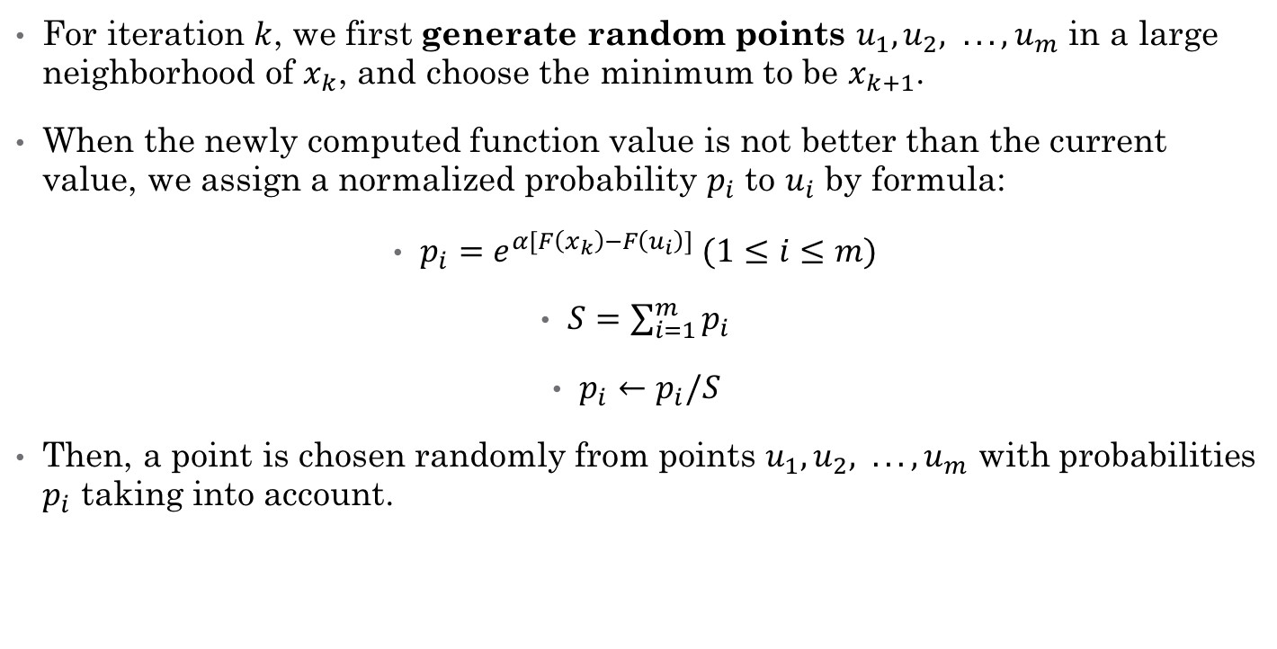
Simulated Annealing
For iteration $k$, we first generate random points $u_{1}, u_{2}, . . . , u_{m}$ in a large neighborhood of $x_{k}$, and choose the minimum to be $x_{k+1}$.
When the newly computed function value is not better than the current value, we assign a normalized probability $p_{i}$ to $u_{i}$ by formula:
$p_{i}=e^{α[F\left(x_{k}\right)−F\left(u_{i}\right)]} (1≤i≤m)$
$S=\sum_{i=1}^{m}{p_{i}}$
$p_{i}←p_{i}/S$
Then, a point is chosen randomly from points $u_{1}, u_{2}, . . . , u_{m}$ with probabilities $p_{i}$ taking into account.

Slide 12
Simulated Annealing
Advantages:
Avoid stuck at local minimum
Disadvantages:
Slow
For smooth problems, SA is overkill
Heuristic methods are often better than general methods
Cannot tell when to stop

Slide 13
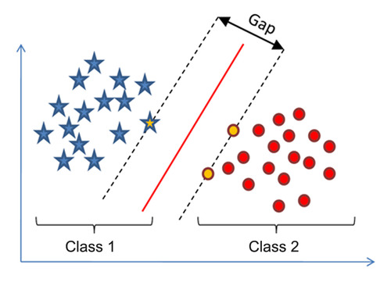
Support Vector Machine (SVM)
A Support Vector Machine (SVM) is a discriminative classifier formally defined by a separating hyperplane, to maximize distances to nearest point (margin)

Slide 14
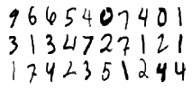

Support Vector Machine (SVM)
C: trades off misclassification of training examples against simplicity of the decision surface.
$γ$: defines how far the influence of a single training example reaches, with low values meaning ‘far’ and high values meaning ‘close’.
Example used here: handwritten digit recognition
Notes:
C: penalty of putting some examples in the wrong group. Larger C tends to make training points more correct

Slide 15
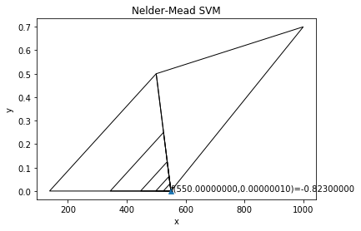
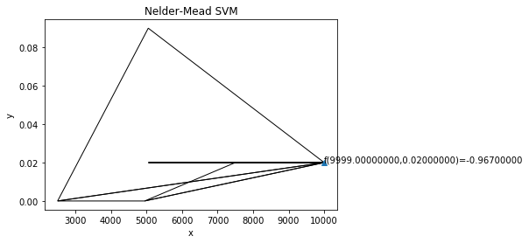
SVM with Nelder-Mead
I.C. (1000,1) (5000,0.1) (10000, 0.01) ⤵️
I.C. (100,1) (500,0.5) (1000, 0.7) ⤴️
Notes:
The graph on the right shows what we get from a bad initial condition, and the graph on the left shows what we get from a good initial condition.
Here the negative of the function is taken to take advantage of the minimization algorithms.

Slide 16
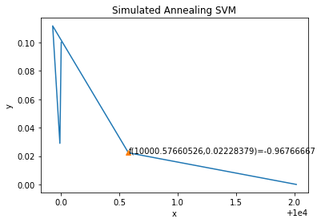
SVM with Simulated Annealing

Slide 17
Conclusion
Both depend a lot on initial condition
Nelder-Mead: stuck at local min
Simulated Annealing: computationally expensive
Better strategy 1:
Start with Grid Search over values differ exponentially
After getting a relatively good point, use Nelder-Mead around that point with smaller tolerance as stopping criteria
Better strategy 2:
Simulated Annealing with larger neighborhood

